Slide 1
Chapter 23

Slide 2
Objectives

Slide 3
Objectives (cont.)

Slide 4
Some of the C# clauses for working with LINQ

Slide 5
Features of LINQ

Slide 6
The three stages of a query operation

Slide 7
A LINQ query that retrieves data from an array

Slide 8
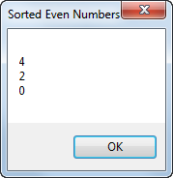
The resulting dialog box

Slide 9
The syntax of the from clause

Slide 10
An example that uses a generic list of invoices as the data source

Slide 11
An example that uses a generic list of invoices as the data source (cont.)

Slide 12
The syntax of the where clause

Slide 13
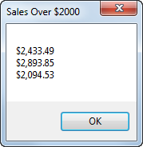
The resulting dialog box

Slide 14
An example that filters the generic list of invoices

Slide 15
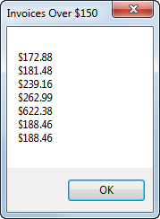
The resulting dialog box

Slide 16
The syntax of the orderby clause

Slide 17
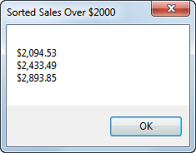
The resulting dialog box

Slide 18
An example that sorts the generic list of invoices

Slide 19
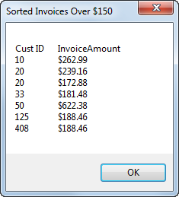
The resulting dialog box

Slide 20
Two ways to code the select clause

Slide 21
An example that selects key values from a sorted list

Slide 22
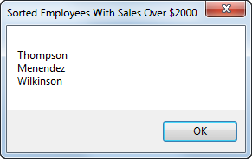
The resulting dialog box

Slide 23
A query expression that creates an anonymous type from the list of invoices

Slide 24
The basic syntax of the join clause

Slide 25
A query expression that joins data from the two data sources

Slide 26
Code that executes the query

Slide 27
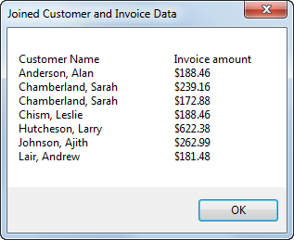
The resulting dialog box

Slide 28
An extension method that extends the String data type

Slide 29
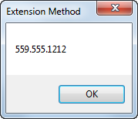
The resulting dialog box

Slide 30
Extension methods used to implement common C# clauses for LINQ

Slide 31
The basic syntax of a lambda expression

Slide 32
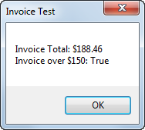
The resulting dialog box

Slide 33
A query that uses extension methods and lambda expressions

Slide 34
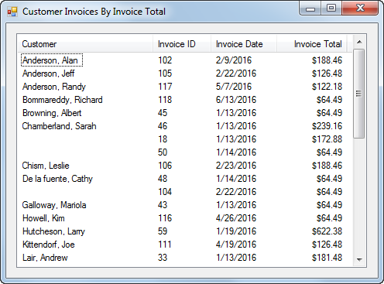
The Customer Invoice form

Slide 35
Customer Invoice form with generic lists

Slide 36
Customer Invoice form with generic lists (cont.)

Slide 37
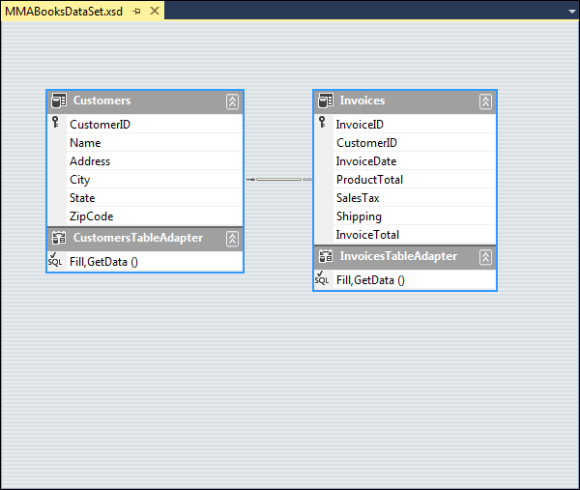
The dataset schema

Slide 38
Customer Invoice form with typed dataset

Slide 39
Customer Invoice form with typed dataset (cont.)

Slide 40
Extra 23-1 Use LINQ to create an Invoice Line Items application

Slide 41
Project 5-2 Display incidents by technician

